Slide 1
Getting Existing Code Under Tests
@LlewellynFalco

Slide 2
90% Coverage in 1 Hour

Slide 3
Agenda
Lock simple code
Lock complex code
Lock system configuration

Slide 4
Pop quiz

Slide 5
Question 1

Slide 6
public void closeConnection()
{
var con = getConnectionForThread();
if (con == null)
{
try
{
con.close();
}
catch
{
//ignore
}
}
}

Slide 7
Bug: close Connection doesn’t

Slide 8
Fix 1: change Code

Slide 9
Fix 2: change NAME

Slide 10
2 Wrongs != Right

Slide 11

But 3 Lefts Do!

Slide 12
Question 2

Slide 13
public double calculate(double amount)
{
int step1 = (int) (amount * 2);
double step2 = step1 * 1.5;
return step2;
}

Slide 14
public double calculate(double amount)
{
int step1 = (int) (amount * 2);
double step2 = step1 * 1.5;
return step2;
}
public double calculate(double amount)
{
return amount * 3;
}

Slide 15
Why?

Slide 16
1 => 3
REFACTORED
Original
1 => 3
-1 => -3
-1 => -3
4 => 12
4 => 12
3.2 => 9.6
3 => 9

Slide 17
public double calculate(double amount)
{
int step1 = (int) (amount * 2);
double step2 = step1 * 1.5;
return step2;
}
Rounds down

Slide 18
How Important is that?

Slide 19
Font Size?

Slide 20
BANKING?

Slide 21
Medication?

Slide 22
Question 3

Slide 23
These 415 lines have been refactored to these 213 lines. Is there a bug?

Slide 24
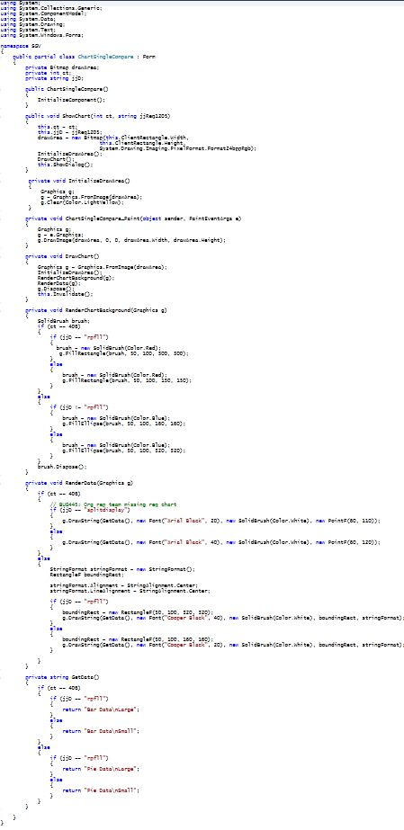
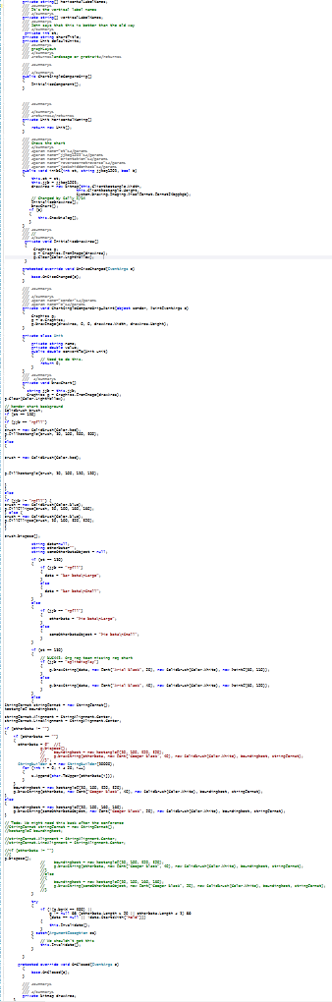
⬅REFACTORED
Original ➔

Slide 25
A: Are the Tests PASSING?

Slide 26


Slide 27


Slide 28
HOW?

Slide 29
Benefits of Unit Tests
Specification
Feedback
Regression
Granularity
Notes:
Both

Slide 30
Benefits of Unit Tests
Specification
Feedback
Regression
Granularity
Notes:
Both

Slide 31
Regression
A
A
If I used to get :
Then I still get :
Notes:
Both

Slide 32
LOCKING Test

Slide 33
FUNCTIONAL is EASY

Slide 34
What does that mean?

Slide 35
Functional
All inputs in
Deterministic
All results out

Slide 36
All inputs in
public double calculate(double amount)
{
int step1 = (int) (amount * 2);
double step2 = step1 * 1.5;
return step2;
}
Deterministic
All results out

Slide 37
All inputs in?
public int Advance()
{
return steps++;
}

Slide 38
All inputs in?
public int age(DateTime birthDate)
{
var timeSpan = DateTime.Now - birthDate;
var age = DateTime.MinValue + timeSpan;
return age.Year-1;
}
Deterministic?

Slide 39
All results out?
public void saveFile(Person info, string fileName)
{
File.WriteAllText(fileName, info.ToString());
}

Slide 40
Demo: Locking Functional

Slide 41

POKE

Slide 42
Demo: Locking Non-functional

Slide 43
FUNCTIONAL is EASY

Slide 44
NON-FUNCTIONAL is HARD

Slide 45
Reduce To Functional
Functional?
Yes
Easy
No
Hard
Reduce to
Functional

Slide 46
The
Peel

Slide 47
The
Slice

Slide 48
The
Slice

Slide 49
The
Slice
Fake

Slide 50
Functional Harness
Functional?
Yes
Easy
No
Hard
Hard
Reduce to
Functional
Functional
Harness

Slide 51
Logging
Log
Easy Capture of behavior
Hard

Slide 52
Files (name & size is usually enough)
FileA 34,368
FileB 15,632
FileC 28,453

Slide 53

Databases
✔

Slide 54
System Configuration
Log
Easy Capture of Configuration
Start

Slide 55
http://bit.ly/ExistingCode

Slide 56
ApprovalTests
A Free & Open Source Verification library

Slide 57
Resources
www.ApprovalTests.com
Working Effectively with Legacy Code by Michael Feathers

Slide 58
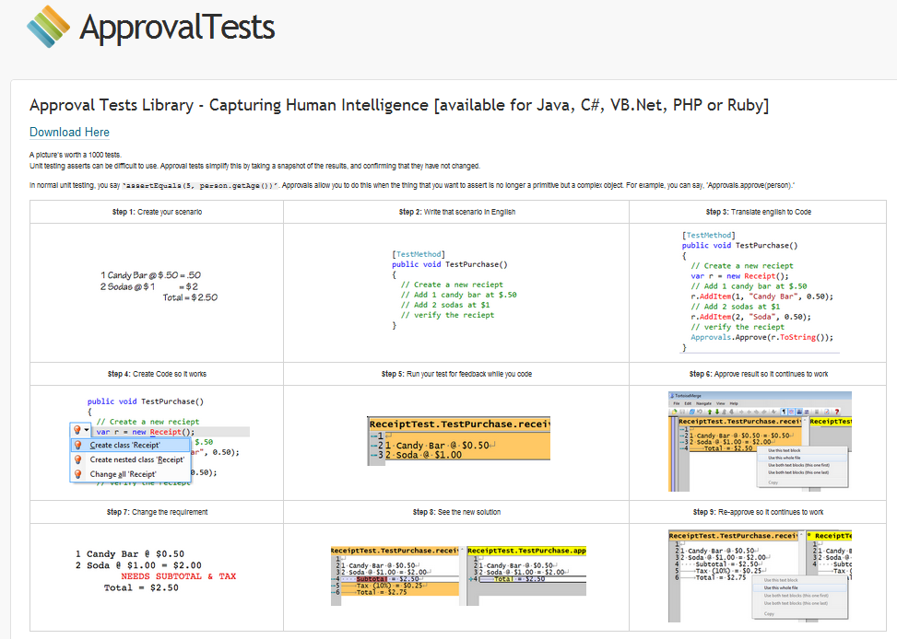
Resources
www.ApprovalTests.com (.net, java, php, ruby)
Herding Code Podcast
Notes:
Both

Slide 59

Resources
www.ApprovalTests.com
21 episode youtube series
Notes:
Both

Slide 60
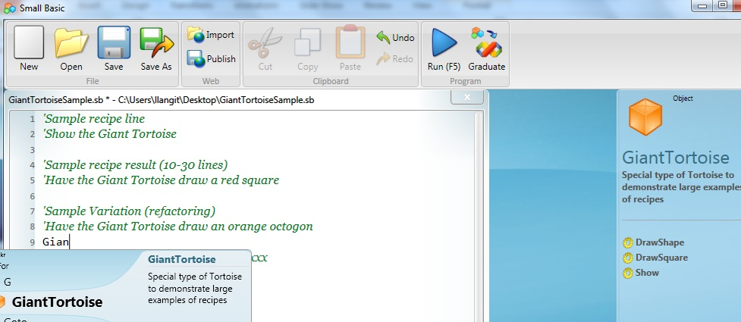
TeachingKidsProgramming.org
Do a Recipe → Teach a Kid (Ages 10 ++)
Microsoft SmallBasic, Java → Free Courseware (recipes)
Notes:
I add this slide at the end of EVERY presentation.

Slide 61

Contact Information
@LlewellynFalco http://LlewellynFalco.Blogspot.com
http://www.approvaltests.com
Notes:
Both

